Slide 1
Societe Generale – Hiring Challenge
Exploratory Data Analysis
BY
Vinod Kumar Reddy Salkuti
Email : vinod.salkuti@gmail.com
Ph.No: +91-9642577077

Slide 2
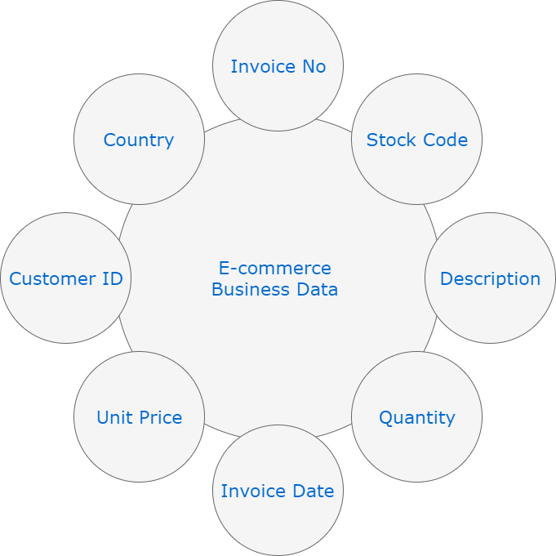
Societe Generale Data Science Recruitment Drive
Company Basic Information
By Looking After the data the company is a Multinational Ecommerce Company. Who are selling the Products like toys , head phones , stationary items like board , women fashion items , jewelry , kitchen items , Napkins and etc.
Attributes on Online Retail Dataset

Slide 3
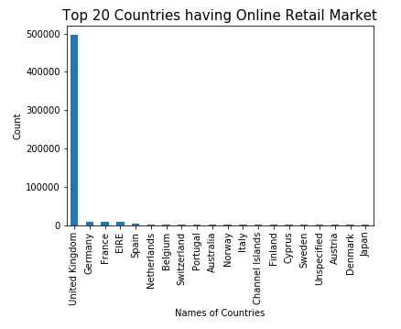
Societe Generale Data Science Recruitment Drive
Insights from Data
Top 20 Selling Countries

Slide 4
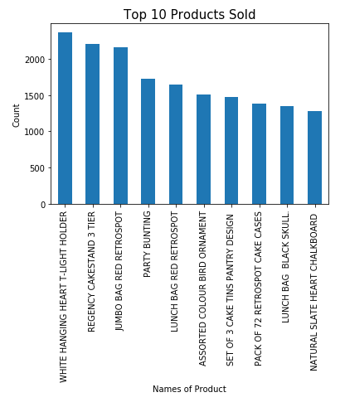
Societe Generale Data Science Recruitment Drive
Insights from Data
Top 10 Products Sold

Slide 5
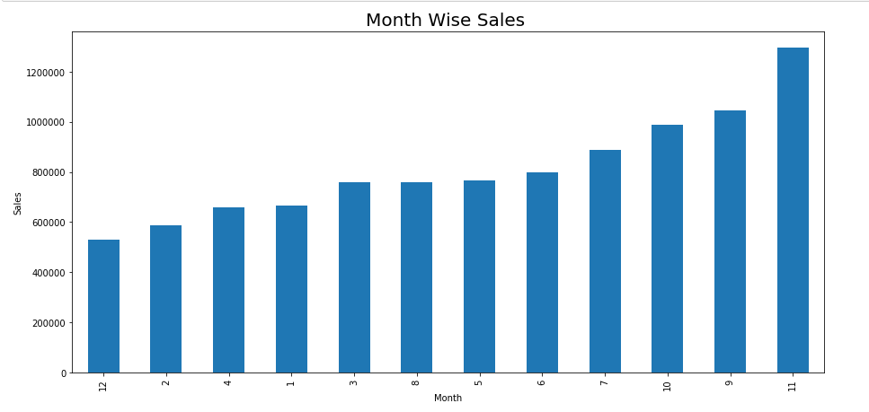
Societe Generale Data Science Recruitment Drive
Insights from Data
Month Wise Sales

Slide 6
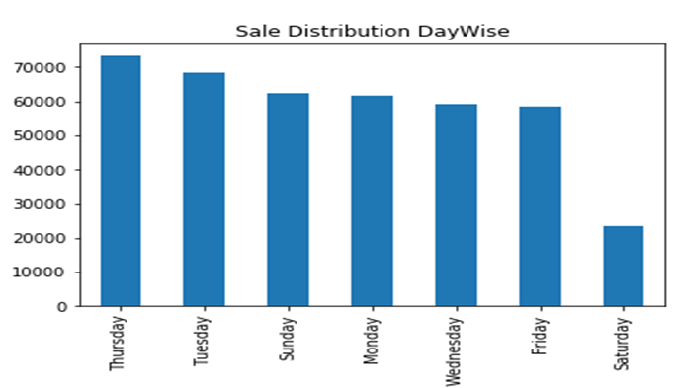
Societe Generale Data Science Recruitment Drive
Insights from Data
Day Wise Sales
Notes:
Note :
Very low sale is happening in top 10 countries on the following days of the week Friday, Saturday and Sunday where as in United Kingdom alone its less only Saturday’s
On an Average Sale is quite high in top 10 Countries on the following days of the week Monday, Tuesday and Thursday

Slide 7
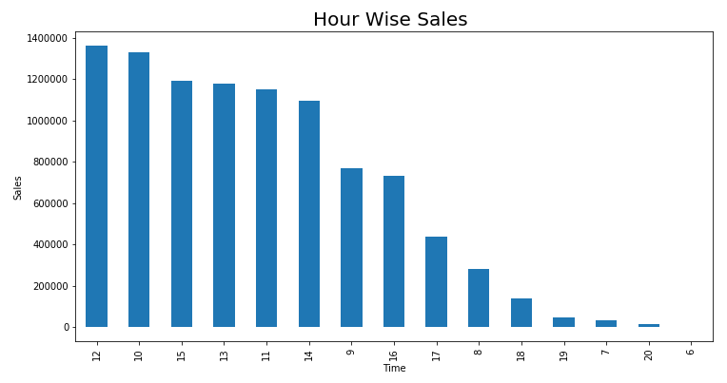
Societe Generale Data Science Recruitment Drive
Insights from Data
Hour Wise Sales
Notes:
Note:
Most of the sales are happening between 10:00 Hrs to 15:00 Hrs Only
This implicates the behavior of the customers, major section id active during the office hours.

Slide 8
Societe Generale Data Science Recruitment Drive
Improvement Areas or Key Recommendations
Most of the sale is happening in UK and we can Improve the sale in other countries
Need to concentrate on Saturday and Sunday sale in top performing Countries
Month Beginning has less sale comparatively with other days
Increase in sales can be done by advertising,promotional offers, discounts coupons,loyality programs or any such additional offers.
Number of cancellations or returns are high which implies customer is not satisfied with the product in terms on one of the following
* Missing timely Delivery
* Quality of the Product is not as per customer expectations.
* Less price offered by competitors for the same product
* Product damages while shipping etc.
The company needs to focus on the above faults and get them corrected to minimize their orders getting cancelled.
The company can tie up with local stores for fast and timely delivery and increase customer satisfaction.
The company can find the other popular online stores in these countries and try to acquire them or tie up with them to promote your brand.

Slide 9
Societe Generale Data Science Recruitment Drive
Other Areas For EDA
Recommendations : We can analyse the customer trends in buying one or more items and recommend the similar products to other customers. Eg: Amazon Recommendations.
Can Analyse the Repeat Customer and their intent Towards the Product and personalization.
Can analyse the customer trend on popular products and do better inventory management.
Can identify outdated items and replace them with alternate trending items. * Can Analyse the Product Availability and show case the demand forecast based on the product.

